Slide 1
Introduction to Psychology
Sensation, Attention & Perception

Slide 2
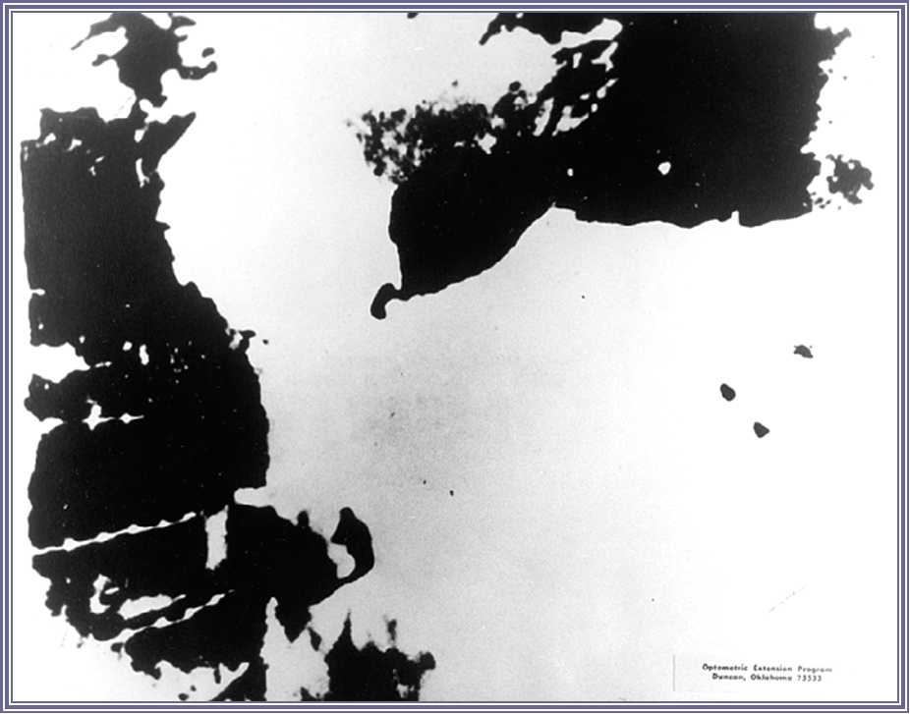

Slide 3
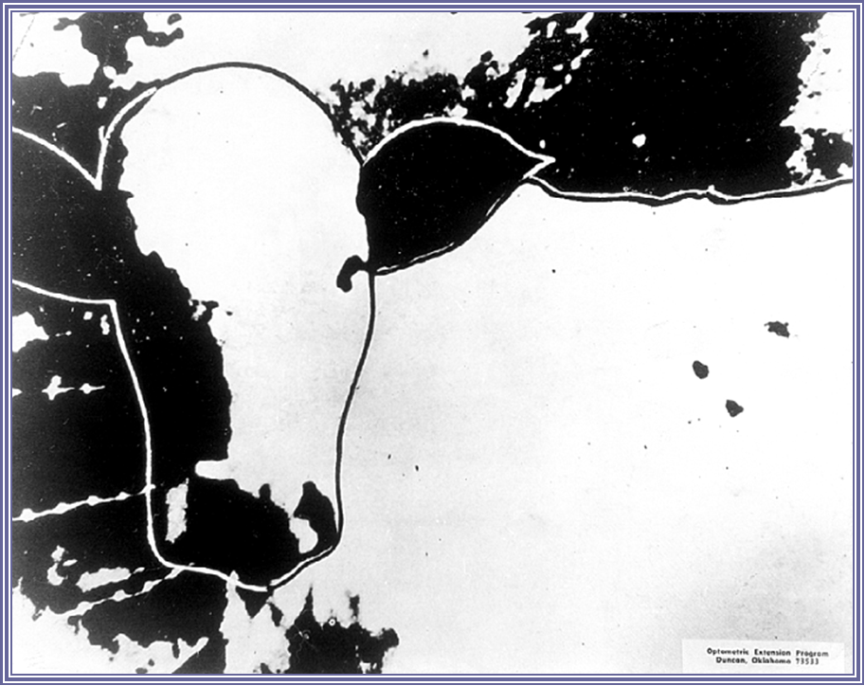

Slide 4
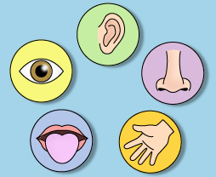


Sensation
The process through which the senses pick up visual, auditory, and other sensory stimuli and transmit them to the brain; sensory information that has registered in the brain but has not been interpreted
Sensation is gathering info from the environment via your senses.
Perception
The process by which sensory information is actively organized and interpreted by the brain
Perception is understanding what is being
sensed!

Slide 5
Perception
From Physical to mental
Perception:
Incoming sensory information is insufficient to explain perception
Considerations of context and of the perceiver's expectations and prior learning must also be made

Slide 6
Bottom-Up/Top-Down processing
Stage 1 - Bottom-up processing
Automatic
data-driven processing
Stage 2 - Top-down processing
Active/Constructive
conceptually-driven processing

Slide 7
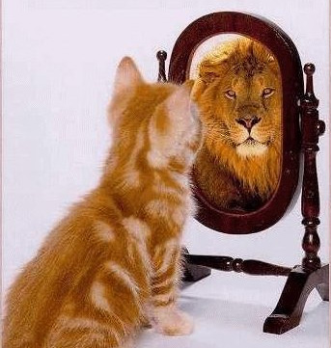
The process of Perception help us in-
Organizing Information
Interpreting Information
Helping us to recognize meaningful objects and events
“ WE DON’T SEE THINGS AS THEY ARE,
WE SEE THINGS AS WE ARE”

Slide 8
Perceptual Process
Sensation
An individual’s ability to detect stimuli in the immediate environment.
Selection
The process a person uses to eliminate some of the stimuli that have been sensed and to retain others for further processing.
Organization
The process of placing selected perceptual stimuli into a framework for “storage.”
Translation
The stage of the perceptual process at which stimuli are interpreted and given meaning.

Slide 9
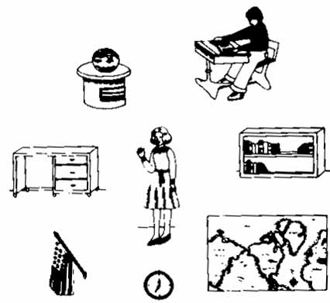

Slide 10
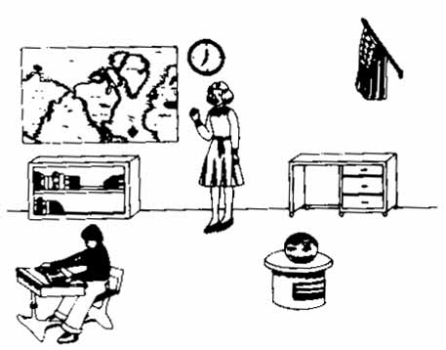

Slide 11
Ted Talk Beau Lotto: Optical illusions show how we see
Beau Lotto's color games puzzle your vision, but they also spotlight what you can't normally see: how your brain works. This fun, first-hand look at your own versatile sense of sight reveals how evolution tints your perception of what's really out there.
https://www.ted.com/talks/beau_lotto_optical_illusions_show_how_we_see

Slide 12
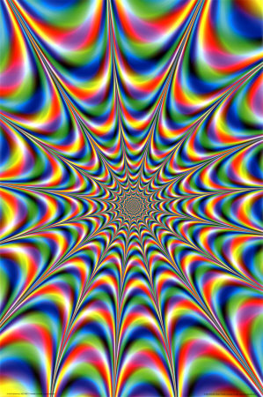
What do we call it when there is a mismatch between sensation and perception – when we misinterpret the info?

Slide 13
Look at the chart and say the COLOUR not the Word
YELLOW ORANGE BLUE
BLACK GREEN RED
YELLOW PURPLE RED
ORANGE GREEN BLACK

Slide 14
Possible Explanation of “Stroop Effect”
Speed of Processing Theory: The interference occurs because words are read faster than colors are named.
Selective Attention Theory: The interference occurs because naming colors requires more attention than reading words.

Slide 15
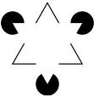
What are fictions?
When you see something that is not there. E.g. the white triangle

Slide 16

Perceptual Process: A Complex Phenomenon
Attention
Which part of the sensory environment to attend to, and
Which information is to further processed or discarded?
Localization:
To determine where objects of interest are?
Recognition
Which objects are out there?
Abstraction
Abstract the critical features of a recognized object
Constancy
Perceptual constancy

Slide 17
Attention
The ability to focus mental resources on something
Attention is limited
Think of attention as a pool of resources
To attend to something: To pay attention to it
“Attended ear” - Paying attention to words in that ear

Slide 18
Focusing on just one thing
Cocktail party metaphor: You are talking to someone at a party with a lot of other people making noise.
You are able to filter out other noise and focus just on the person you’re talking to. How do you do that?

Slide 19
Localization
Localization
To determine ‘Where’ objects of interest are?
Separation of Object
The image projected on retina is a mosaic of varying brightness and colors
Perceptual system organizes that mosaic into a set of discrete objects projected against a background
Figure and Background
Figure: Object of interest
Appear more solid than the background
Appear in front of the background
Background: region that appears behind the figure

Slide 20

Figure and Background
The picture on the left shows a gray object (figure) resting on a white field (ground). The picture on the right shows a gray object (figure) with a hole in it (all placed on the white background).

Slide 21
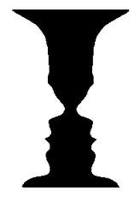

General Rule: Smaller an area or shape, the more likely
it is to be seen as figure

Slide 22
Figure and Background: Context and Content
In common use almost every word has many shades of meaning, and therefore needs to be interpreted by the context.“
(Alfred Marshall, Principles of Economics, 8th ed., 1920)

Slide 23
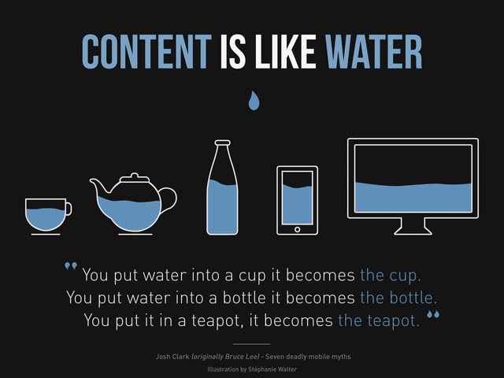

Slide 24
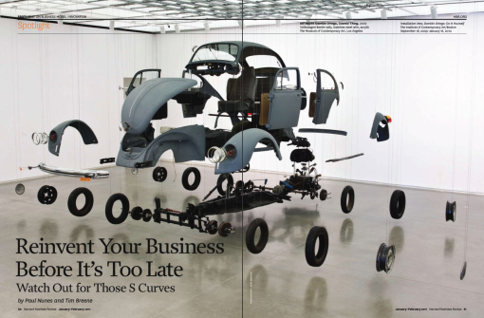
Gestalt Psychology: “The sum of the Whole is Greater than its Parts” When the perceptual system forms a percept or gestalt, the whole thing has a reality of its own, independent of the parts
Organizational pundits
suggests that this describes the “synergy”, which exists between
individuals working together
in a cooperative effort
“The whole works better than
any one of its parts”

Slide 25
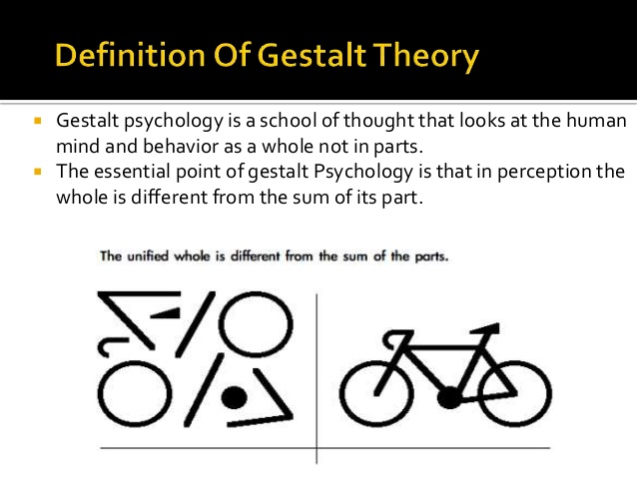

Slide 26
Gestalt Laws of Grouping
We tend to group collections of shapes, sizes, colors, and other features into perceptual wholes
It explains how people transform raw visual input—lights, shadows, lines, points, shapes, and colors—into meaningful displays
Grouping is not arbitrary but follows simple rules
Gestalt Grouping Principles
Proximity--group nearby figures together
Similarity--group figures that are similar
Continuity--perceive continuous patterns
Closure--fill in gaps
Connectedness--spots, lines, and areas are seen as unit when connected

Slide 27
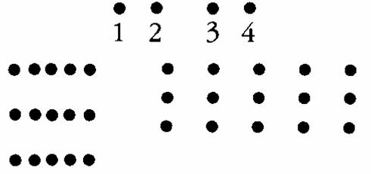
Law of Proximity
The groups we see are
1 + 2 = as one group 3 + 4 = as another group
Similarly, on the left, three groups of dots in three lines. What happens with the evenly spaced dots?
The principle of proximity or contiguity states that things which are closer together will be seen as belonging together

Slide 28


Proximity: Element which are close are perceived as a shape
In an easy and brilliant way the designer use the proximity law to create a shape of an island and its reflection on the sea. This is the perfect combination of the brand name and the customer activity, dance music producer. The lines creating the island are clearly recognizable as equalizer lines.
A group of single objects, representing foods (bread, fish, vegetables are clearly recognizable) which grouped for proximity create a car shape.

Slide 29
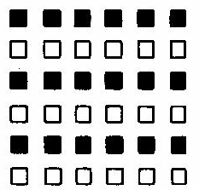
Law of Similarity
Similarity means there is a tendency to see groups which have the same characteristics so in this example, there are three groups of black squares and three groups of white squares arranged in lines.
The principle of similarity states that things which share visual characteristics such as shape, size, color, texture, value or orientation will be seen as belonging together.

Slide 30

The Unilever Logo makes clever use of the principle of similarity.
We group blue objects that are similar in color (and maybe size)
to form a larger “U”, initial of Unilever.

Slide 31

Law of Common Fate
Suppose both principles of proximity and similarity are in place - then a movement takes place - the dots begin to move down the page.
They appear to change grouping.

Slide 32

Law of Common Fate
The Melbourne 2010 Cycling Championship logo makes clever use of the law
of common fate to make the circles appear as a single group “moving” in the
same direction and at the same speed, just like cyclists would on a track.

Slide 33
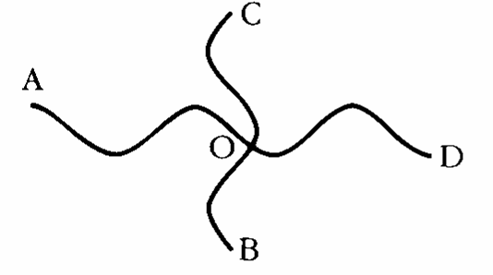
Law of Continuity
Continuation occurs when the eye is compelled to move through one object and continue to another object.
A to O and O to D are two lines. Similarly, C to O and O to B are two lines.

Slide 34

In the logo above, our mind will naturally follow the smooth curve
between the H until the tip lead to the maple leaf. You won’t notice that there is actually NO specific line or contour except just a tip at the right and a missing space between the H.

Slide 35

Law of Closure
Brain tends to perceive forms and figures in their complete appearance despite the absence of one or more of their parts, either hidden or totally absent

Slide 36

WWF and IBM Logo

Slide 37
Perceiving Distance: Depth Perception
Retina provides two dimensional surface on which three dimensional world is projected
Depth Perception
ability to see objects in three dimensions
allows us to judge distance

Slide 38
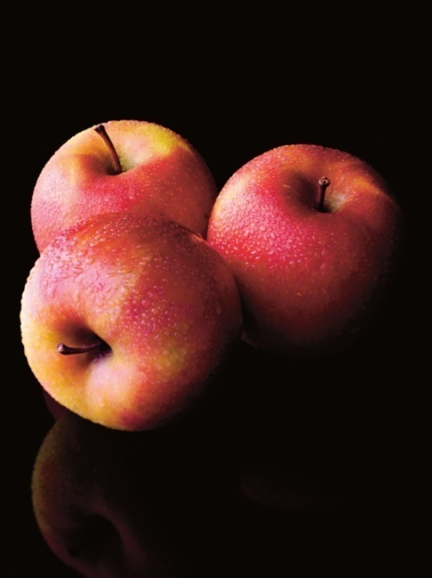
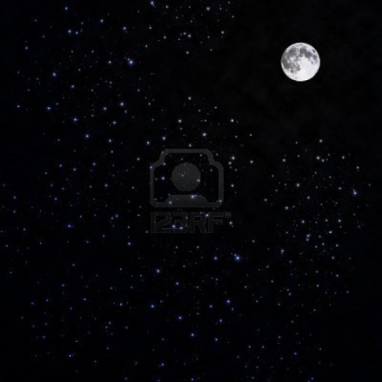
Overview
Depth perception is the ability to see things in a 3-Dimensional way and to judge distance.
We use depth cues to gather information on the images we see.
These cues can be monocular or binocular.

Slide 39
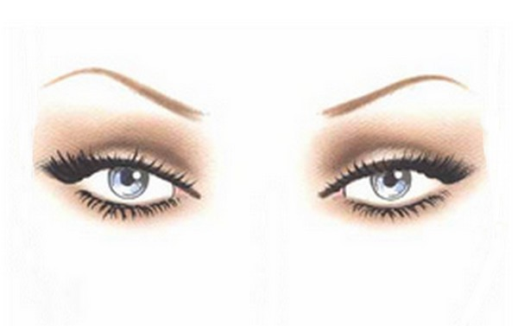
Binocular Cues
Binocular depth cues use both eyes to perceive information on the 3-dimensional form of an object and it's place in space.
Images seen through both eyes are examples of steroptic vision because the two eyes see two different pictures that combine as one.
Binocular cues:
Retinal Disparity
Convergence.

Slide 40
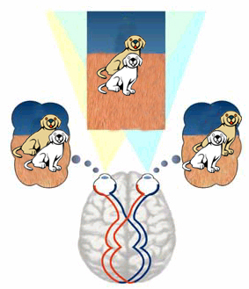
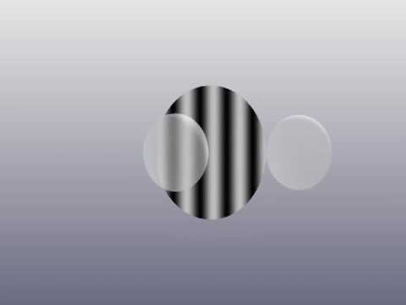
Binocular Cues
The image your right eye sees is different than your left eye because they are a small distance apart. The image you see using both eyes is the two images merged.

Slide 41
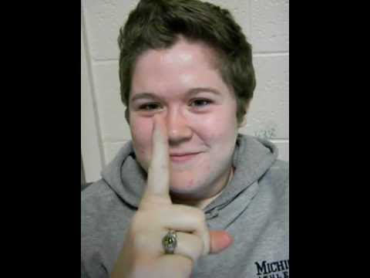
Binocular Cues: Convergence
When focusing on images less than 4-6 meters away, the eyes turn inward to focus on the same object rather than moving together.
The angle the eyeballs turn towards each other is smaller when the object in focus is farther away.

Slide 42
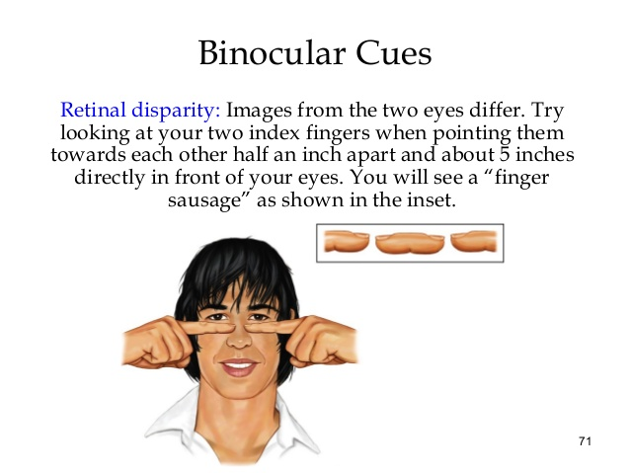

Slide 43
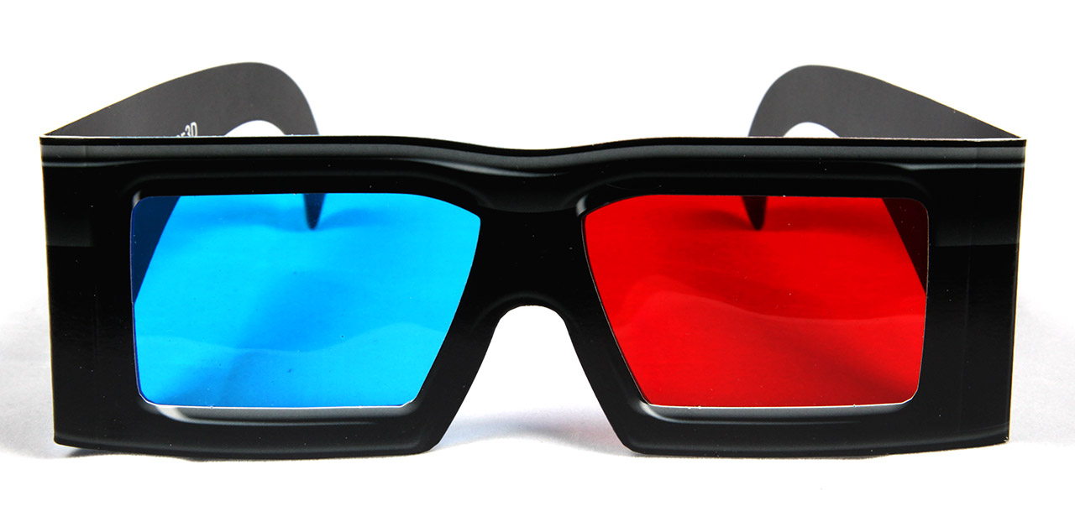
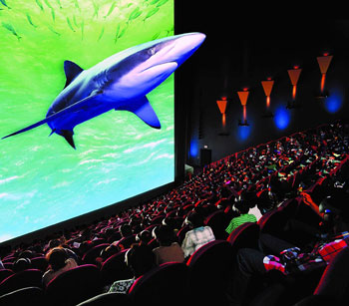
Binocular Cue: Fun Fact
3-D movies use the idea of retinal disparity by using two close cameras and merging the image together.

Slide 44
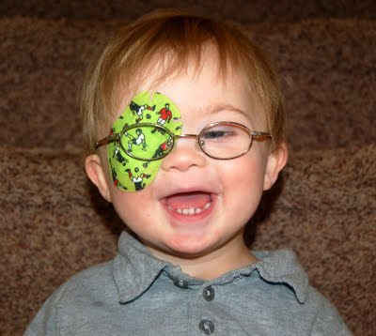
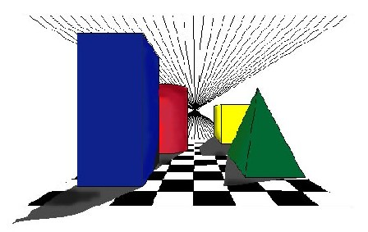
Monocular Cues
Monocular cues judge the distance of an object using only one eye.
Also Known as Pictorial Cues
These cues are often used in making 2-D images appear to be 3-D, in this case they are called pictorial depth cues.

Slide 45

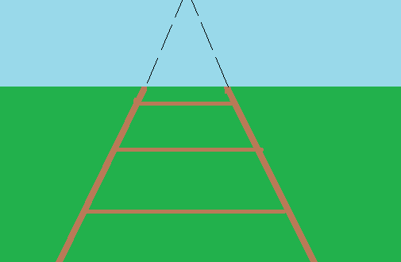
Monocular Cues: Linear Perspective
As parallel lines extend into the distance, they appear to meet together.

Slide 46
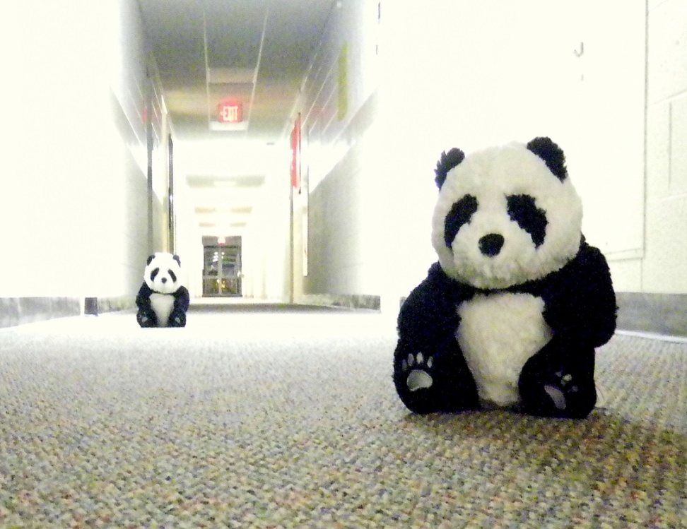
Monocular Cues: Relative Size
When viewing two congruent objects, the farther away object will appear smaller even though the objects are still the same size.

Slide 47
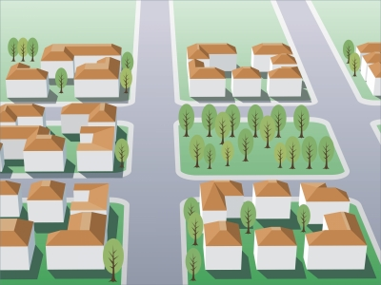
Monocular Cues: Height in the Picture Plane
Objects that are farther away appear higher up in an image, closer to the horizon line.

Slide 48
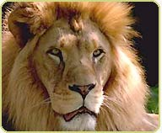
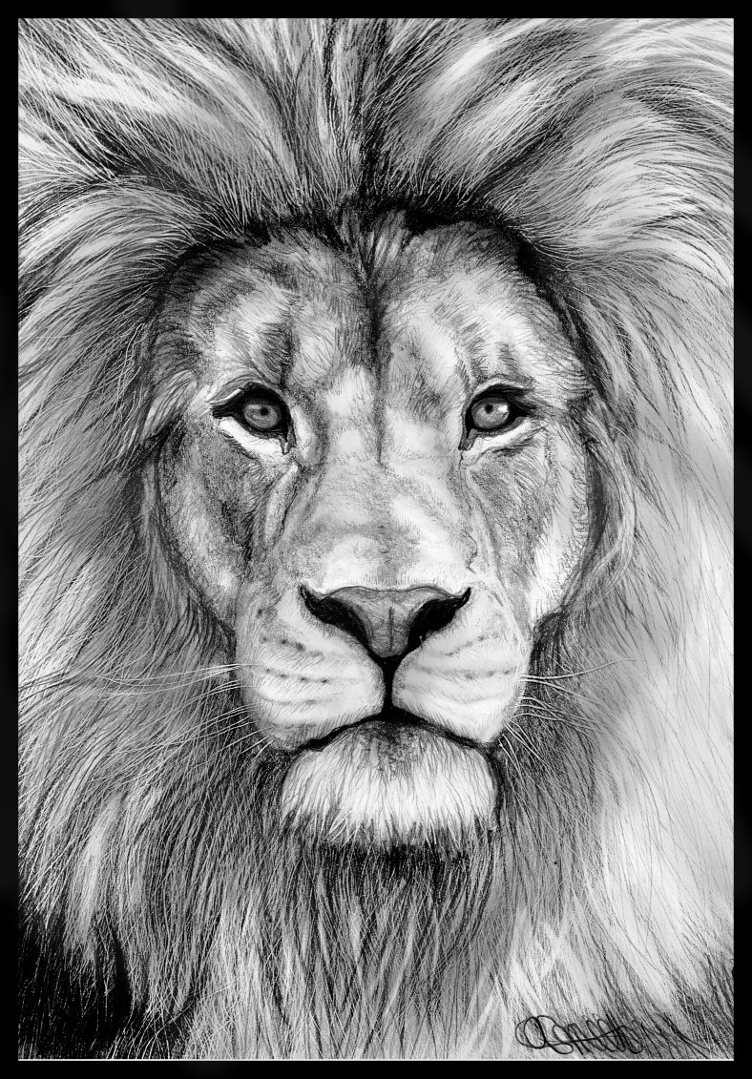
Monocular Cues: Lights and Shadows
2-Dimensional images can appear 3-D when shaded with the appropriate patterns of light and shadow found in "real objects."

Slide 49
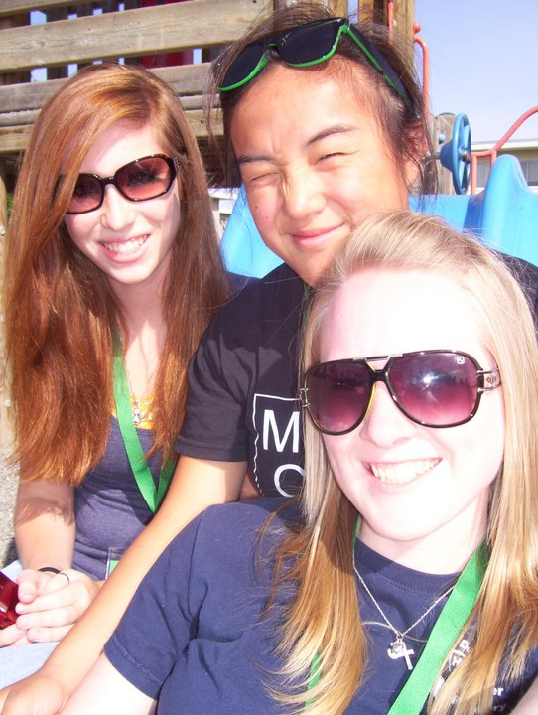
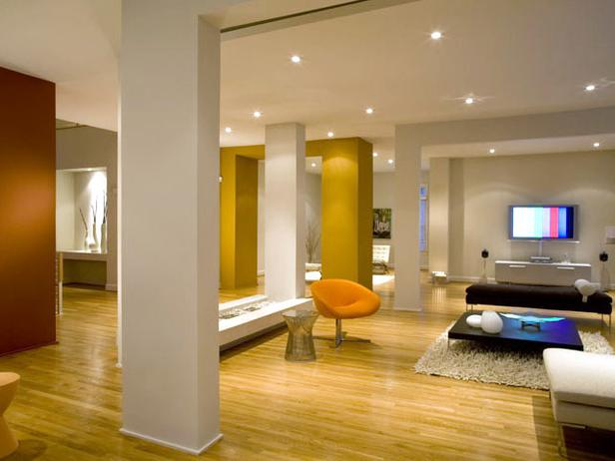
Monocular Cues: Overlap
When multiple objects are in the same visual field, the closest object appears in front of those farther away.

Slide 50
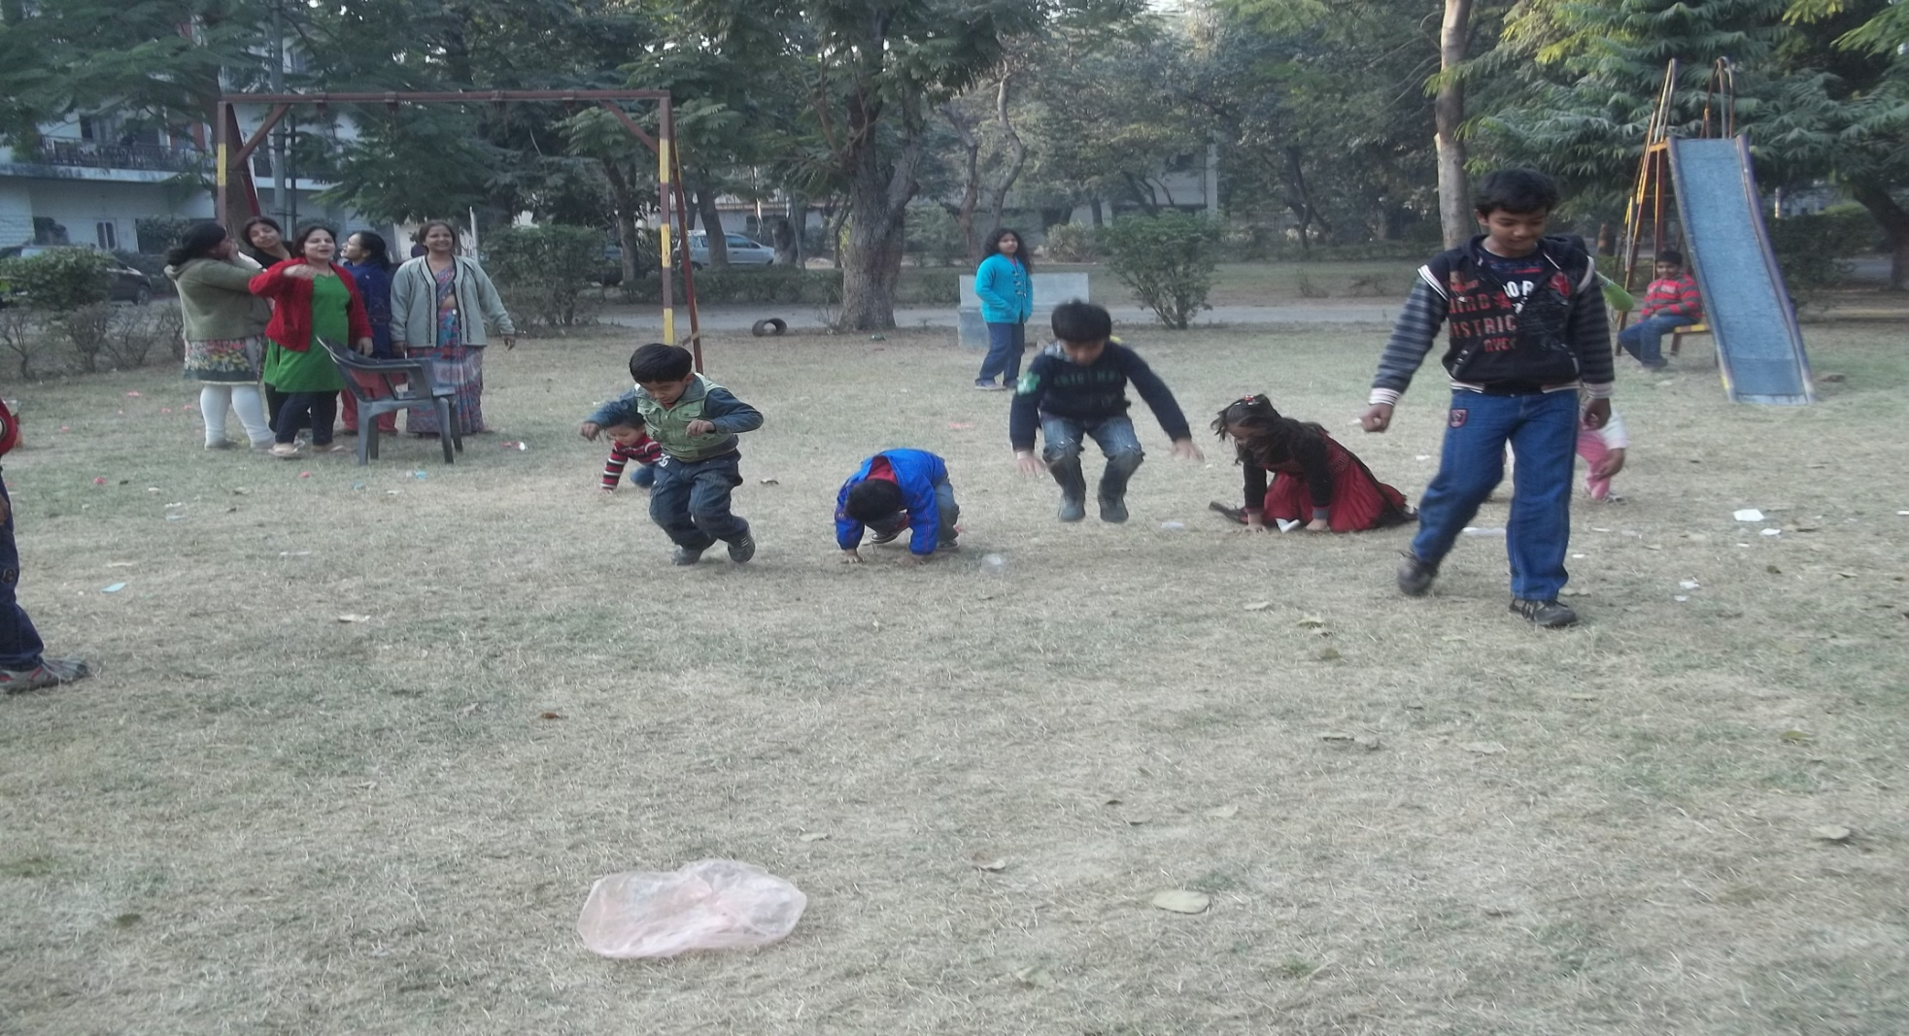
Monocular Cues: Texture Gradient
The texture in an image appear less detailed as objects become more distant.

Slide 51


Monocular Cues: Aerial Perspective
Far away objects often appear less clear in color and detail due to haze.
A person typically only notices the haze when it is not present. On a clear day, far away objects may seem very close.

Slide 52
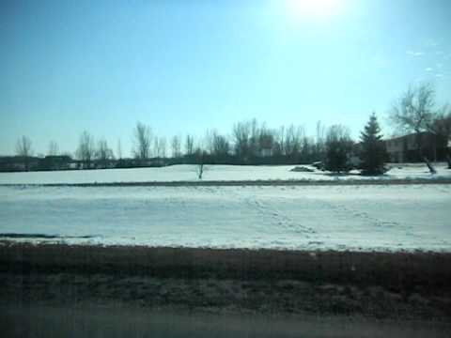
Monocular Cues: Relative Motion
Objects closer in the visual field appear to move by faster than those at a greater distance. The far away objects may not seem like they are moving at all.

